Slide 1
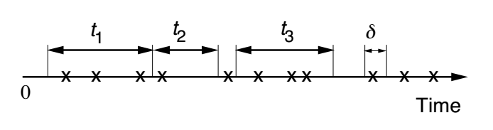
Poisson Process
Continuous analogue of Bernoulli process
Can be described as points on a line
OR, as an increasing staircase that goes up
by one at every point

Slide 2
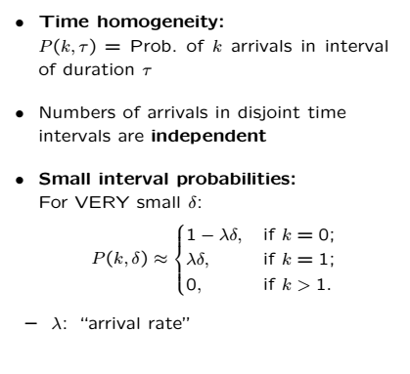
Definition

Slide 3


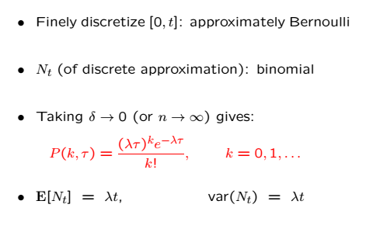
PMF of Number of Arrivals
Number of arrivals during an interval of length t is

Slide 4
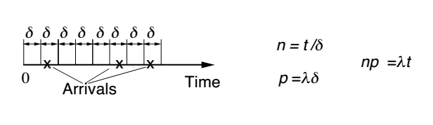
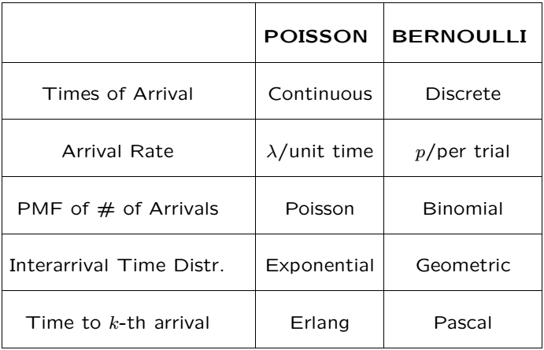
Bernoulli Poisson Relation

Slide 5


Binomial Poisson Relation
Binomial (n,p) PMF converges to Poisson PMF
Large n, small p ( , ),
AKA “Poisson Limit Theorem”
Can be generalized to Binomial process and Poisson process
We said before that binomial is like Gaussian for large n
So Gaussian is the same as Poisson???

Slide 6
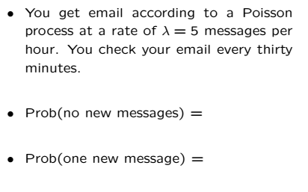
Example

Slide 7
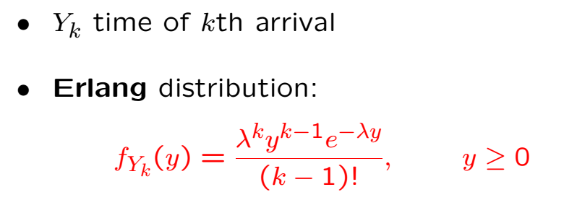
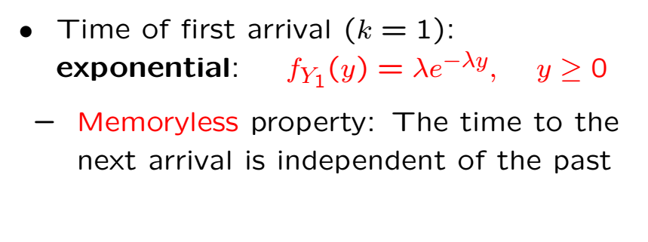
Interarrival Times

Slide 8
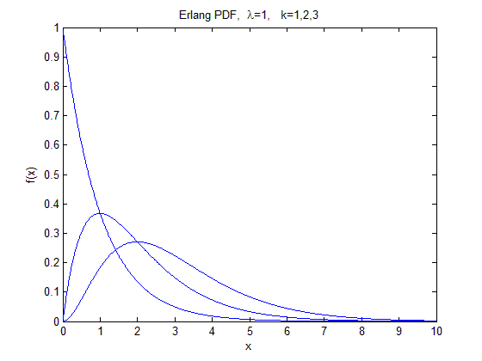
Erlang PDF

Slide 9
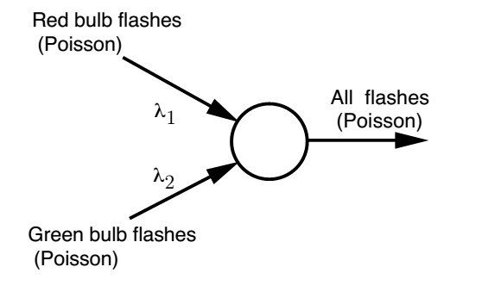

Merging of Poisson Processes
Merged process has parameter $λ_{1}+λ_{2}$

Slide 10
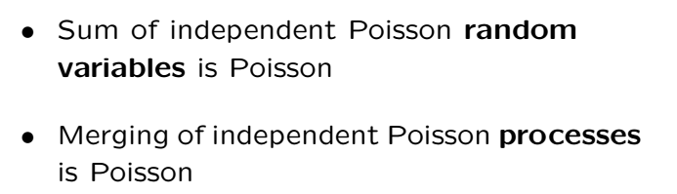


Merging of Poisson Cont’
This is the prob that one exponential will be less than another
$$λ_{1}/(λ_{1}+λ_{2})$$

Slide 12
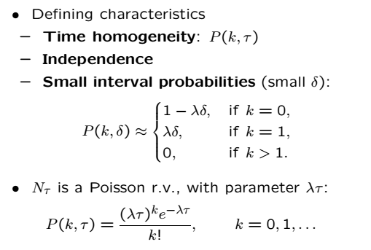
Review

Slide 13
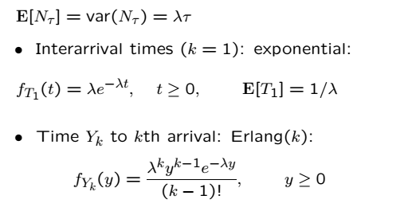
Review Cont’

Slide 14
Acknowledgements and Citations
Parts of these slides are adapted from the following resources:
Power Point Lecture Slides for the Textbook http://bcs.wiley.com/hebcs/Books?action=index&bcsId=8676&itemId=1118324560
John Tsitsiklis. 6.041 Probabilistic Systems Analysis and Applied Probability, Fall 2010. (Massachusetts Institute of Technology: MIT OpenCourseWare),http://ocw.mit.edu (Accessed 13 Apr, 2015). License: Creative Commons BY-NC-SA

